Slide 1

Building & Mining Knowledge Graphs
(KEN4256)
Lecture 3: Knowledge Graph Quality

Slide 2
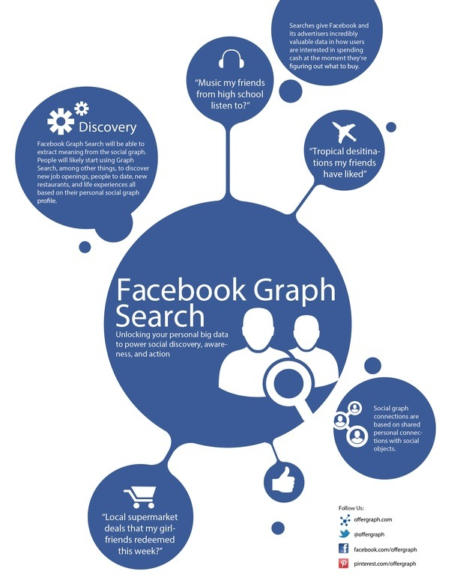

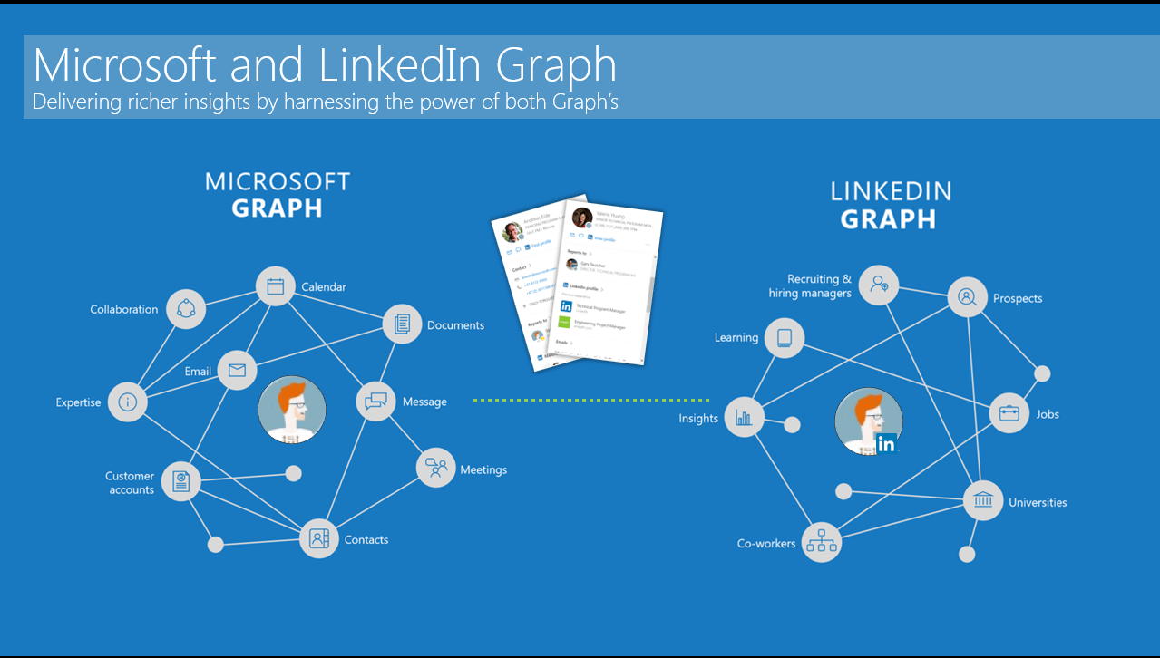
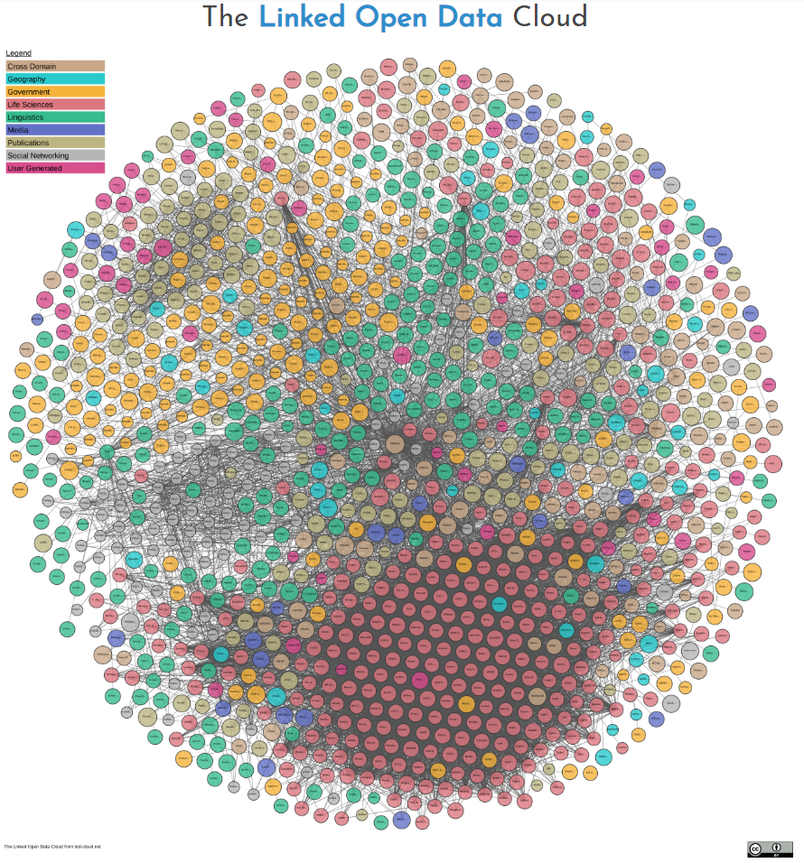






Wealth of KGs available

Slide 3

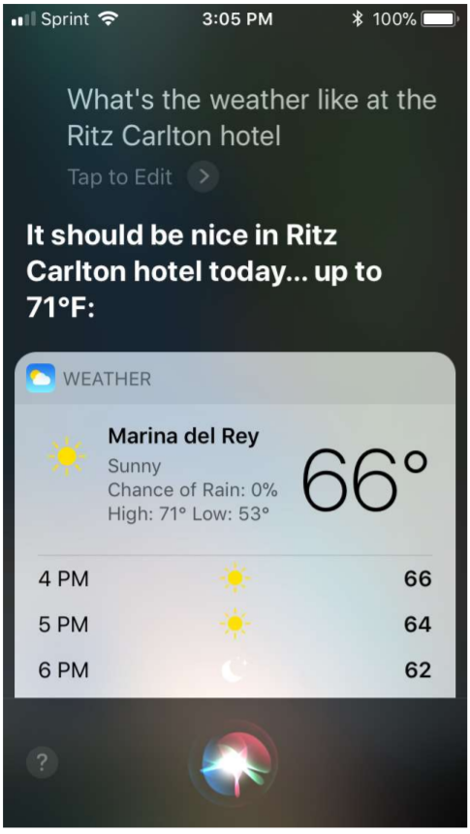
KGs enable powerful applications

Slide 4
BUT….

Slide 5
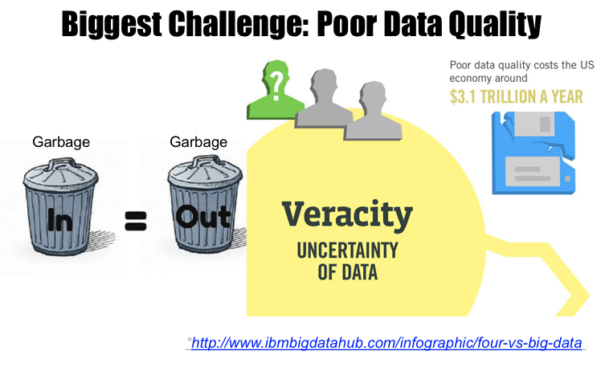

Slide 6
Consequences of Poor Data Quality - Inaccuracy
IBM Watson delivered ‘unsafe and inaccurate’ cancer recommendations
In one example, a patient was recommended a drug that could lead to severe or fatal hemorrhage while he was already dealing with severe bleeding due to his condition. In another example, a Florida doctor who reviewed the system told the company that the technology is "a piece of shit."
https://www.massdevice.com/report-ibm-watson-delivered-unsafe-and-inaccurate-cancer-recommendations/

Slide 7

Consequences of Poor Data Quality - AI Bias
When Google Translate converts news articles written in Spanish into English, phrases referring to women often become ‘he said’ or ‘he wrote’.
https://www.nature.com/articles/d41586-018-05707-8

Slide 8
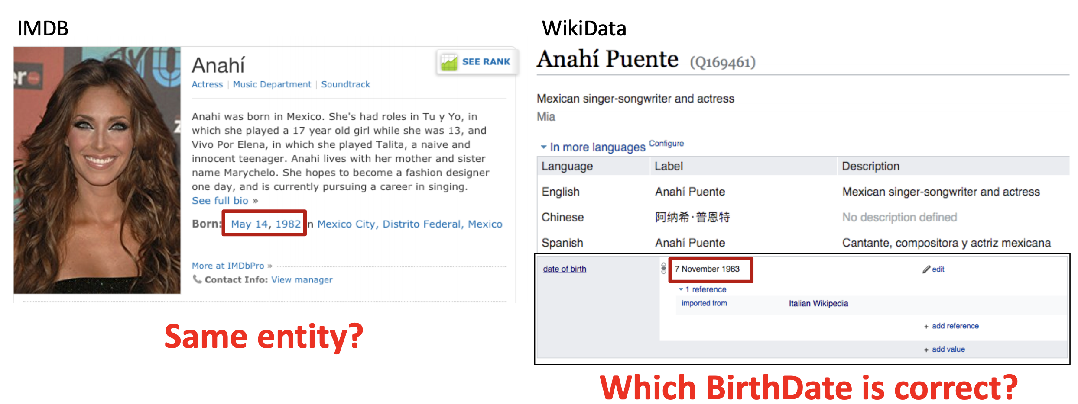
Quality issues in Integrating Data

Slide 9
Trustworthiness
Information Providers
want that their information is used / believed
might want to state their publishing intent (assertion, quote)
are only willing to put a certain effort into publishing
Information Consumers
want to use the information for different tasks
have different views of the world
have different subjective trust requirements
have different subjective preferences for certain trust mechanisms

Slide 10
What is Data Quality?
Data Quality: commonly conceived as a multi-dimensional construct with a popular definition ‘fitness for use’*.
Dimension: characteristics of a dataset.
Metric: or indicator is a procedure for measuring an information quality dimension.
*Juran et al., The Quality Control Handbook, 1974

Slide 11
Quality Assessment Goal
Fix data quality issues in the KG
Root cause analysis: identify source of quality issues
quality issues in the source data
arising due to data integration
incorrect use of vocabularies
linking to data from untrustworthy sources
Assess and ultimately improve the quality of the KG

Slide 12
Quality Dimensions & Metrics

Slide 13
Which quality issues did you encounter?
What do YOU think are the different quality criteria?
Notes:
Open Questions to the students
Coverage, freshness, correctness, trustworthiness
Can anyone give examples of data quality issues you noticed thus far when working with KGs in this course?

Slide 14
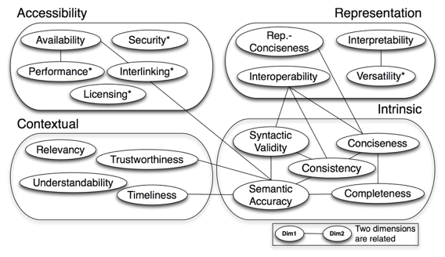
Data Quality Dimensions for KGs
Quality assessment for linked data: A survey. A Zaveri, A Rula, A Maurino, R Pietrobon, J Lehmann, S Auer. Semantic Web 7 (1), 63-93

Slide 15
Use Case - Intelligent Flight Search Engine
Aggregates data from several datasets
airports and airlines from airline datasets
location of countries, cities and particular addresses
aggregators pull all the information related to flights from different booking services

Slide 16

KG Quality Dimensions -
Accessibility
Availability - extent to which data (or some portion of it) is present, obtainable and ready for use
Metrics:
accessibility of the SPARQL endpoint and the server
dereferenceability of the URI
Interlinking - degree to which entities that represent the same concept are linked to each other, be it within or between two or more data sources
Metrics:
detection of the existence and usage of external URIs (target dataset)
detection of all local in-links or back-links: all triples from a dataset that have the resource’s URI as the object
Example:
Interlink “America” and “United States”.
Notes:
When an HTTP client can look up a URI using the HTTP protocol and retrieve a description of the resource, it is called a dereferenceable URI.

Slide 17

KG Quality Dimensions -
Intrinsic
Syntactic Validity - degree to which an RDF document conforms to the specification of the serialization format.
Metrics:
detecting syntax errors using (i) validators, (ii) via crowdsourcing
by (i) use of explicit definition of the allowed values for a datatype, (ii) syntactic rules (type of characters allowed and/or the pattern of literal values)
Example:
Literals (e.g. date) are tagged with appropriate datatype.

Slide 18

KG Quality Dimensions -
Intrinsic
Completeness - refers to the degree to which all required information is present in a particular dataset.
Metrics:
Schema - ontology completeness
Property - missing values for a specific property
Population - % of all real-world objects of a particular type
Interlinking - degree to which instances in the dataset are interlinked
Example:
Include all airports and airport codes to find flights between two places.

Slide 19

KG Quality Dimensions -
Contextual
Trustworthiness - defined as the degree to which the information is accepted to be correct, true, real and credible.
Metrics
annotating triples with provenance data and usage of provenance history to evaluate the trustworthiness of facts
FAIR provenance and metadata, provenance ontologies (PROV-O, HCLS)
opinion-based method, which use trust annotations made by several individuals
Example:
Flight information is from a known airline provider.

Slide 20

KG Quality Dimensions - Representational
Interoperability - degree to which the format and structure of the information conforms to previously returned information as well as data from other sources.
Metrics:
detection of whether existing terms from all relevant vocabularies for that particular domain have been reused
usage of existing vocabularies for a particular domain
Example:
Re-use existing vocabulary to represent different concepts: e.g. WGS 84 geodetic system and GeoRSS points for location

Slide 21
Tools for KG
Quality Assessment

Slide 22
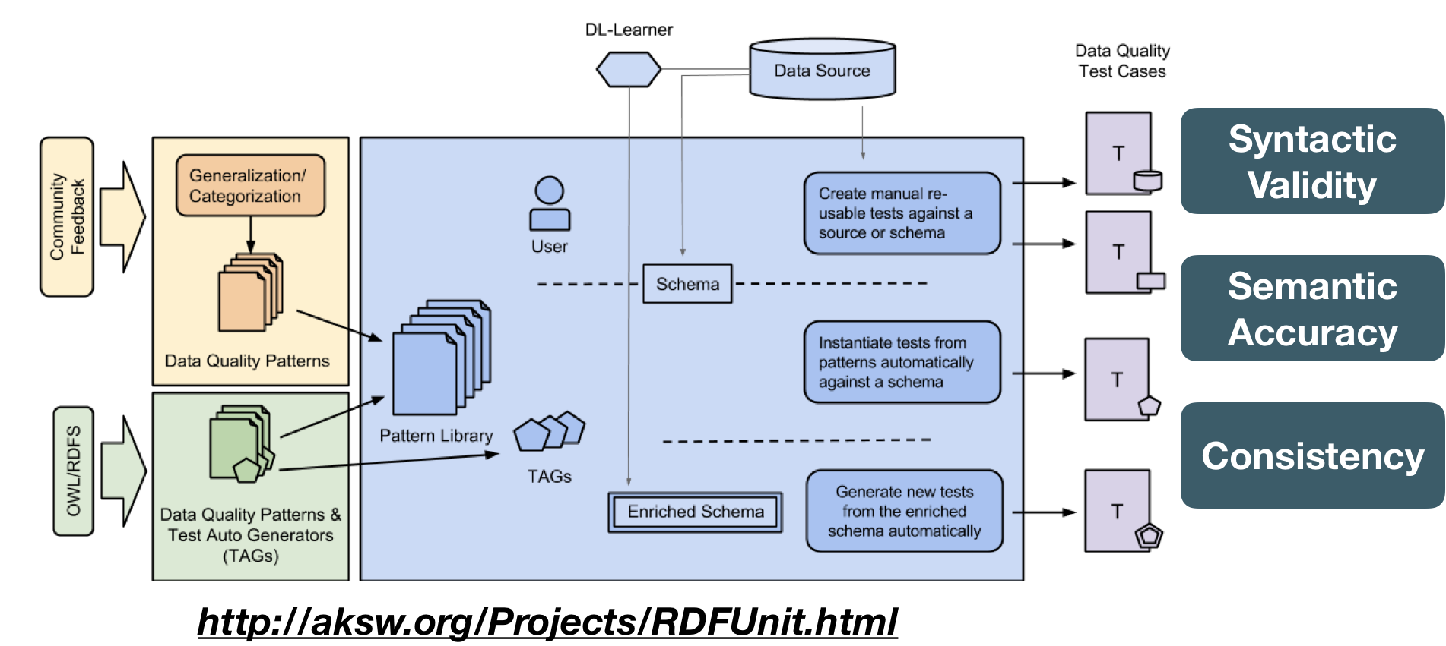
DQA Tool - RDFUnit

Slide 23
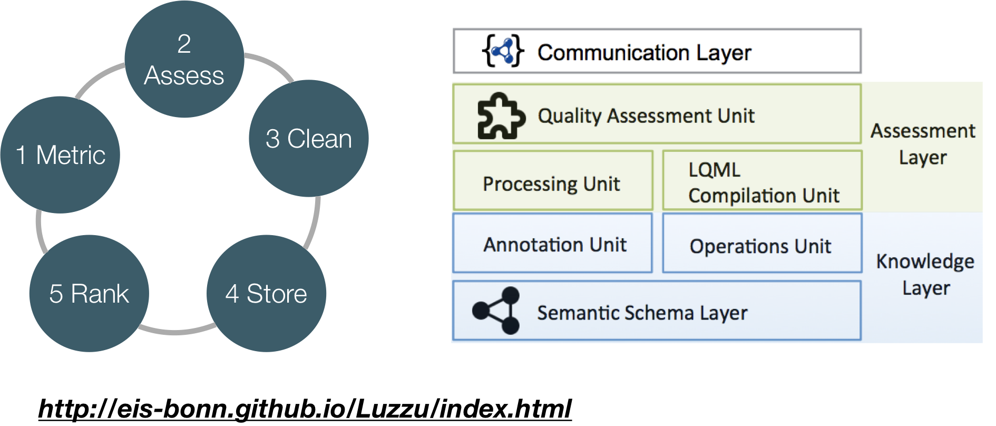
DQA Tool - Luzzu

Slide 24
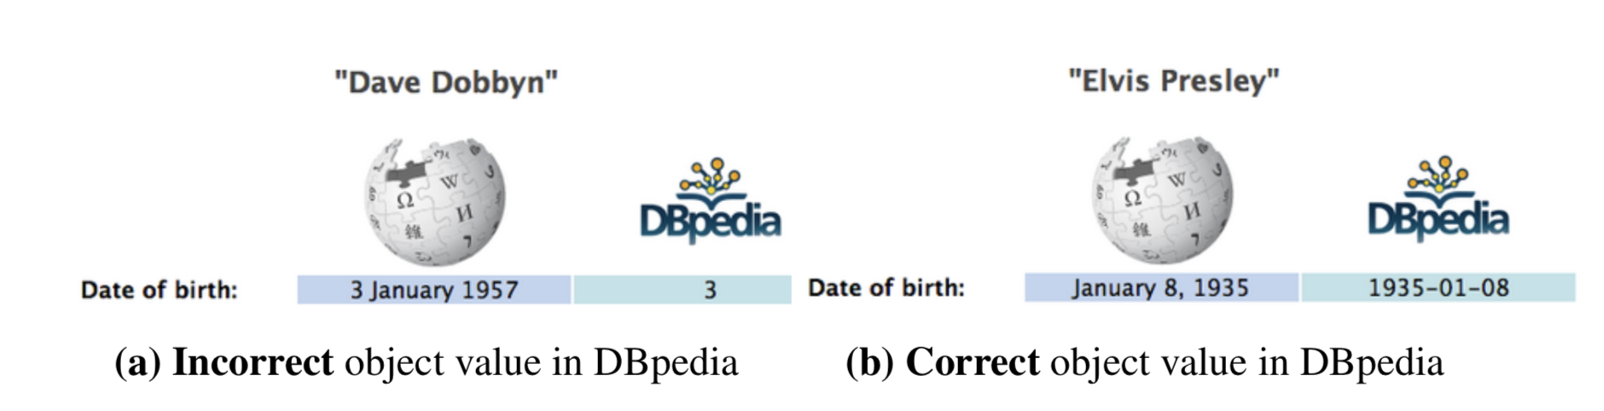
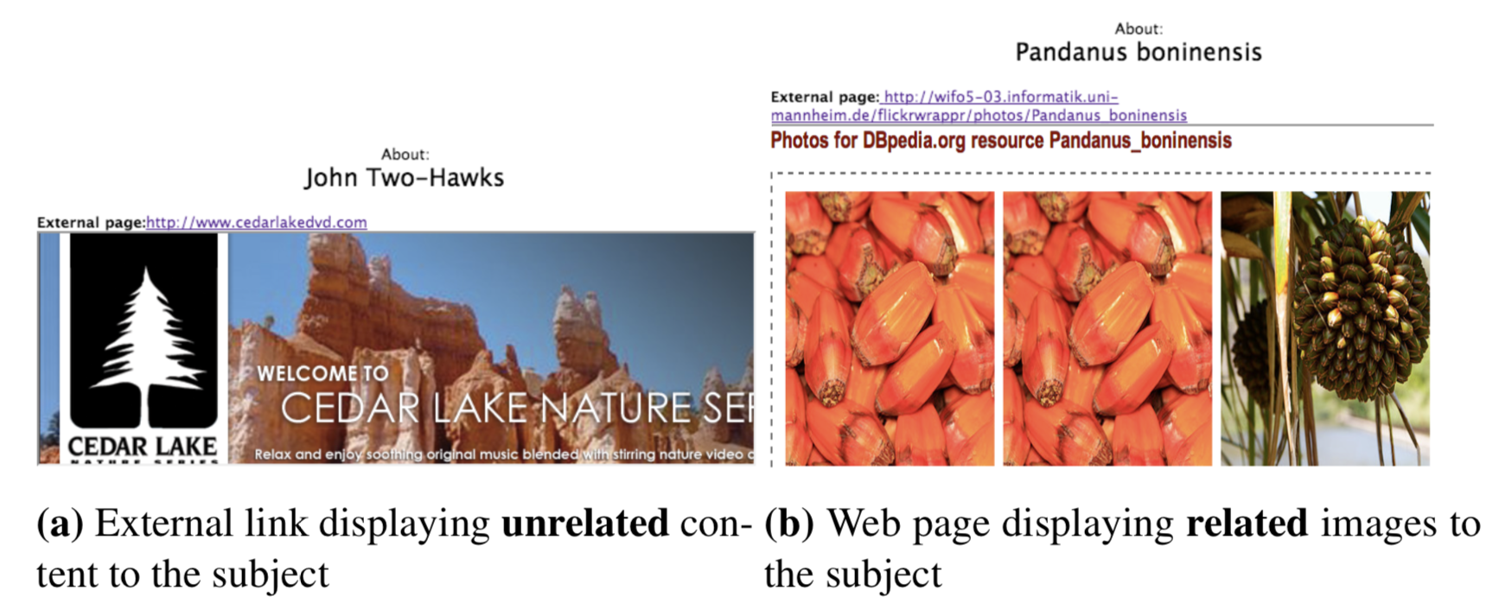
Crowdsourcing Quality Assessment

Slide 25
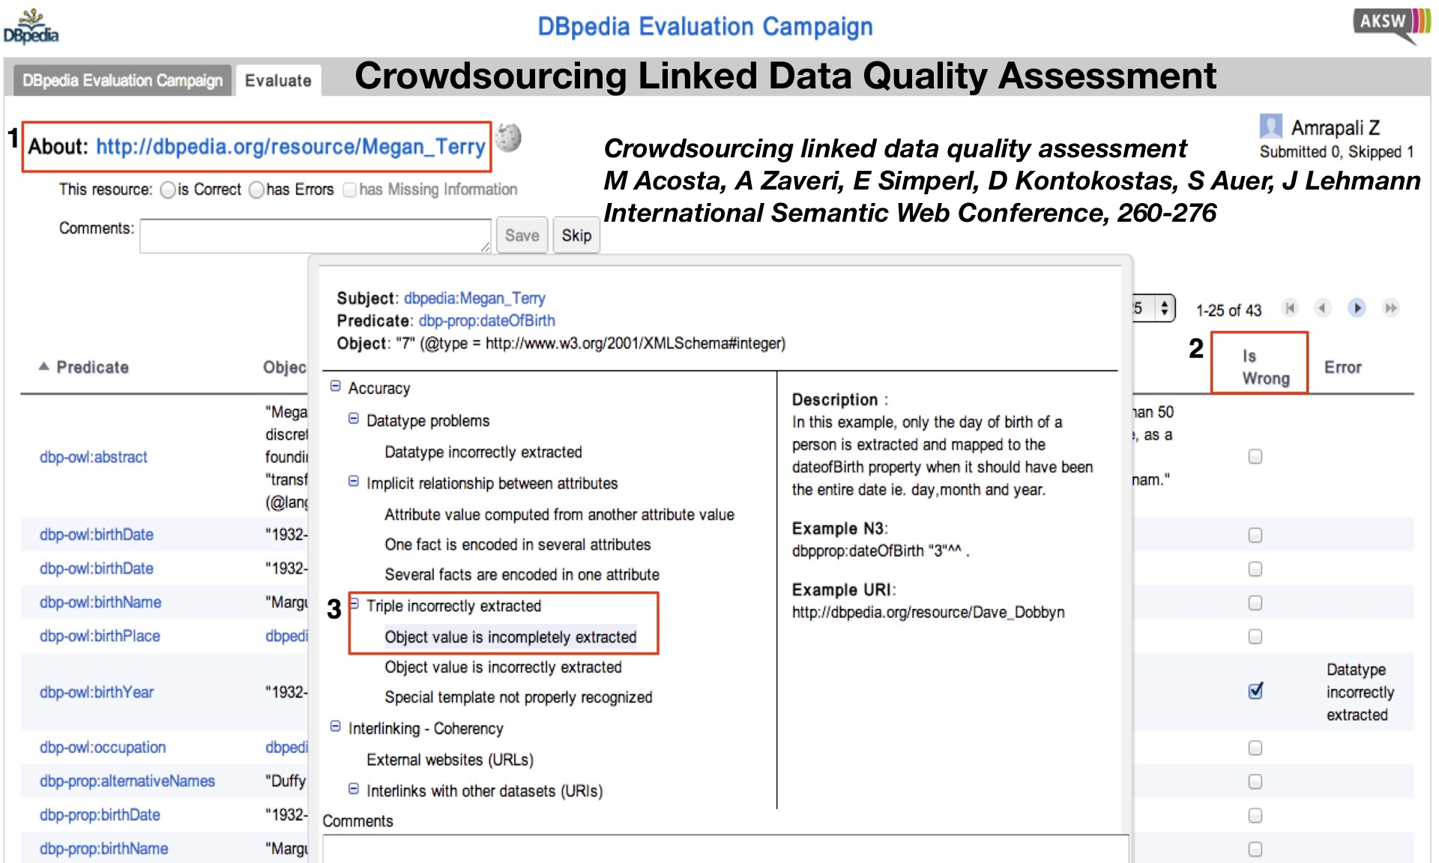

Slide 26

DQA Tool - Shape Expressions
Shape Declaration
Shape Validation
PREFIX : <http://example.org/> PREFIX schema: <http://schema.org/> PREFIX xsd: <http://www.w3.org/2001/XMLSchema#>
:User { schema:name xsd:string ; schema:birthDate xsd:date? ; schema:gender [schema:Male
schema:Female ]
OR xsd:string ; schema:knows IRI @:User* }
alice schema:name "Alice" ; # Passes as a :User schema:gender schema:Female ; schema:knows :bob . :bob schema:gender schema:Male ; # Passes as a :User schema:name "Robert"; schema:birthDate "1980-03-10"^^xsd:date .
:dave schema:name "Dave"; # Fails as a :User schema:gender "XYY"; schema:birthDate 1980 . # 1980 is not an xsd:date *)

Slide 27
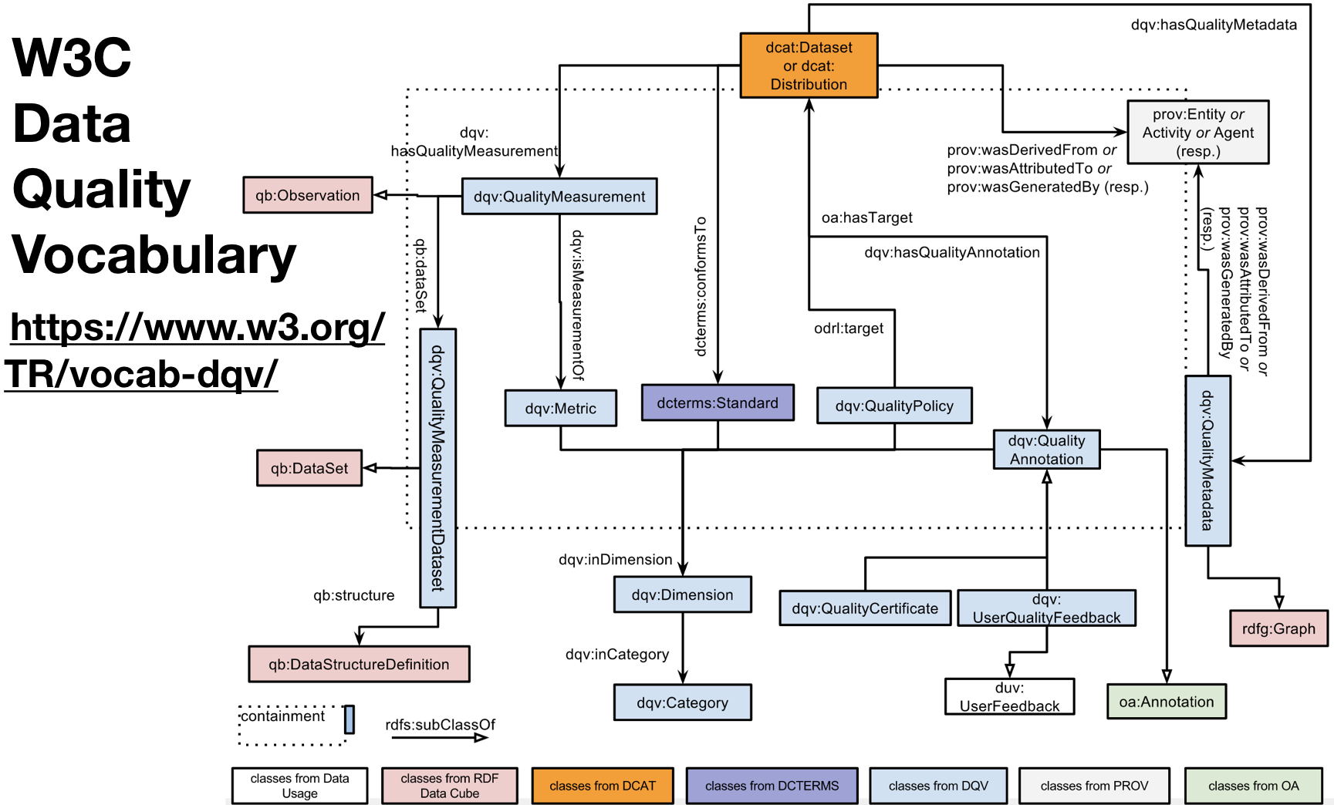

Slide 28
Data Quality Assessment Challenges
Propagation of errors
Management/Improvement
Usage of the standard vocabulary
Quality-based search engines

Slide 29
Questions?

